Slide 1
CHAPTER 3 Introduction to the Quantum Theory of Solids
generalize these concepts to the electron in a crystal lattice.
Develop the concept of allowed and forbidden electron energy bands in a single-crystal material, and describe conduction and valence energy bands in a semiconductor material.
Discuss the concept of negatively charged electrons and positively charged holes as two distinct charge carriers in a semiconductor material.
Develop electron energy versus momentum curves in a single-crystal material, which yields the concept of direct and indirect bandgap semiconductor materials.
Discuss the concept of effective mass of an electron and a hole.
Derive the density of quantum states in the allowed energy bands.
Develop the Fermi-Dirac probability function, which describes the statistical distribution of electrons among the allowed energy levels, and define the Fermi energy level.

Slide 2
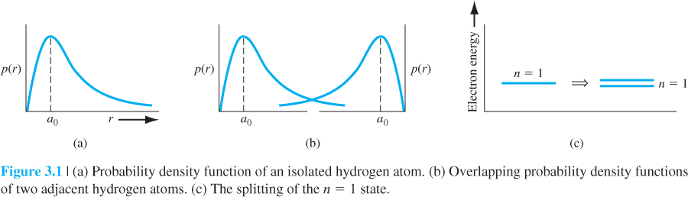
3.1 | ALLOWED AND FORBIDDEN ENERGY BANDS
3.1.1 Formation of Energy Bands
The wave functions of the electrons of the two atoms overlap, which means that the two electrons will interact.
This interaction or perturbation results in the discrete quantized energy level splitting into two discrete energy levels,

Slide 3
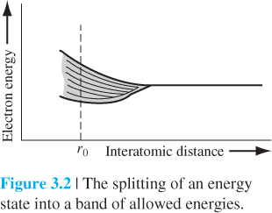
pushing the atoms together, the initial quantized energy level will split into a band of discrete energy levels. This energy difference is extremely small, so that for all practical purposes, we have a quasi-continuous energy distribution through the allowed energy band.
A change in velocity of 1 cm/s compared with 10⁷ cm/s results in a change in energy of
5.7 x 10⁻⁹ eV, which is orders of magnitude larger than the change in energy of 10⁻¹⁹ eV between energy states in the allowed energy band. This example serves to demonstrate that a difference in adjacent energy states of 10⁻¹⁹ eV is indeed very small, so that the discrete energies within an allowed band may be treated as a quasi-continuous distribution.

Slide 4
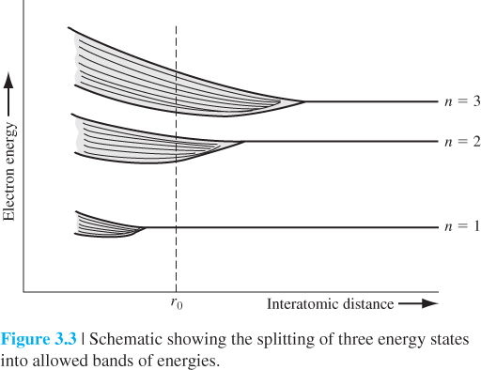
the outermost electrons in the n = 3 energy shell will begin to interact initially,

Slide 5
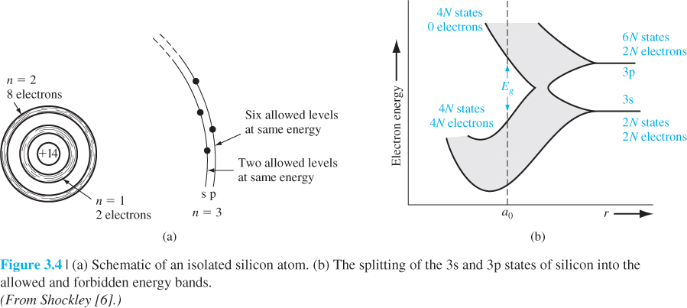
At the equilibrium interatomic distance, the bands have again split, but now four quantum states per atom are in the lower band and four quantum states per atom are in the upper band.
The bandgap energy Eg between the top of the valence band and the bottom of the conduction band is the width of the forbidden energy band.

Slide 6
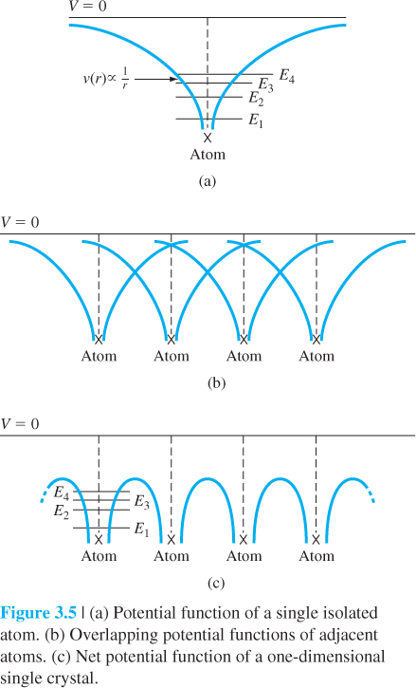
*3.1.2 The Kronig–Penney Model
It is this potential function we would need to use in Schrodinger’s wave equation to model a one-dimensional single-crystal material.

Slide 7
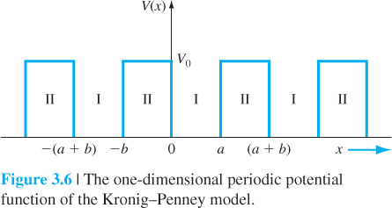

Slide 11
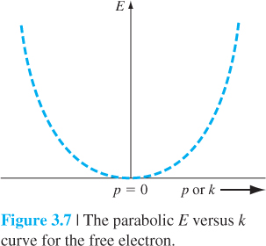
3.1.3 The k-Space Diagram

Slide 12
consider the relation between E and k from Equation (3.24) for the particle in the single-crystal lattice.

Slide 13
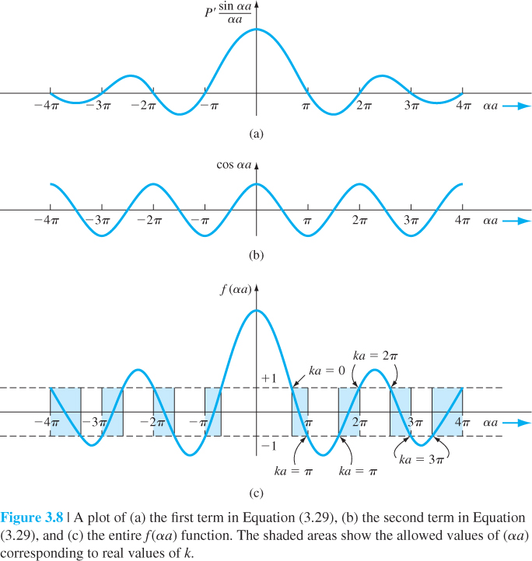
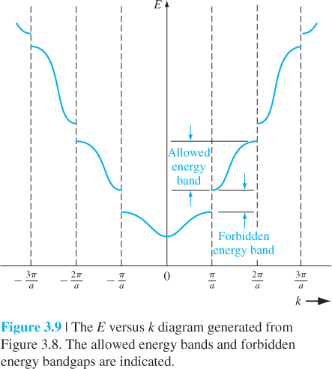
Figure 3.9 shows the concept of allowed energy bands for the particle propagating in the crystal lattice.

Slide 14
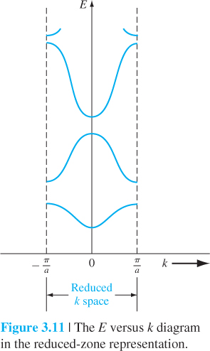
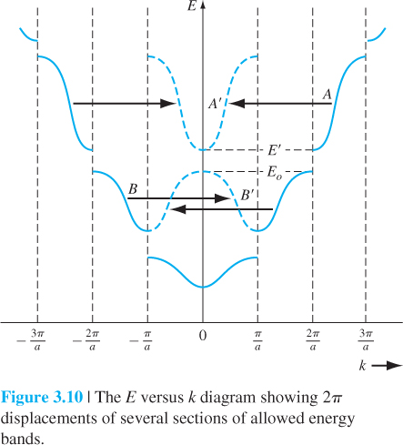
This plot is referred to as a reduced k-space diagram, or a reduced-zone representation.

Slide 15
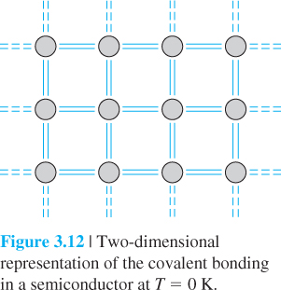
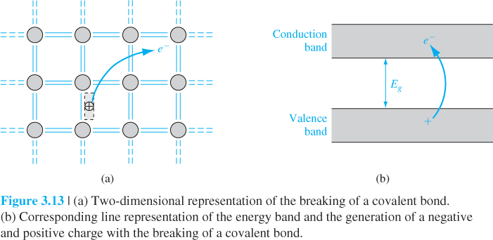
3.2 | ELECTRICAL CONDUCTION IN SOLIDS
At T = 0 K, the 4N states in the lower band, the valence band, are filled with the valence electrons.
The semiconductor is neutrally charged. This means that, as the negatively charged electron breaks away from its covalent bonding position, a positively charged “empty state” is created in the original covalent bonding position in the valence band.

Slide 16
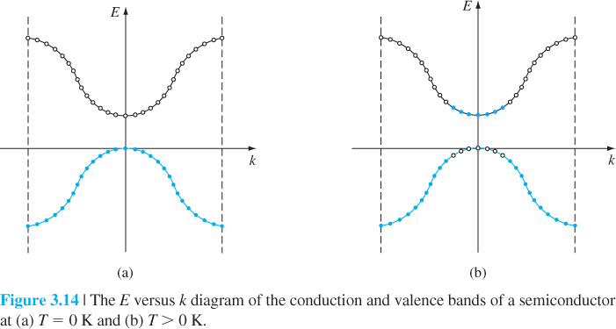
3.2.2 Drift Current

Slide 17
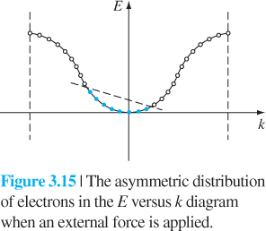

Slide 18
3.2.3 Electron Effective Mass

Slide 19
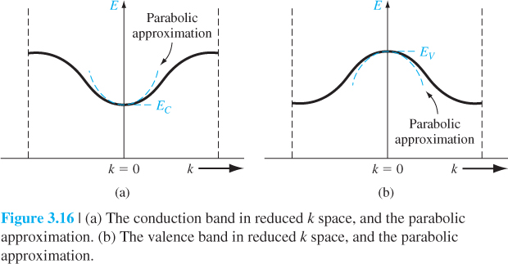
The energy near the bottom of this energy band may be approximated by a parabola, just as that of a free particle.

Slide 20
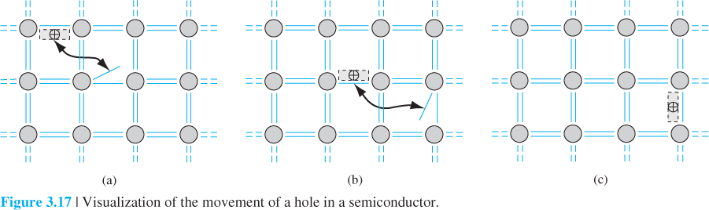
3.2.4 Concept of the Hole
the movement of valence electrons in the crystal, alternately filling one empty state and creating a new empty state—a motion equivalent to a positive charge moving in the valence band. The crystal now has a second equally important charge carrier that can give rise to a current. This charge carrier is called a hole

Slide 22
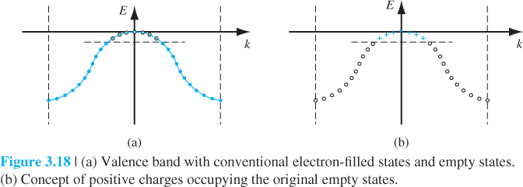
the valence band with the conventional electron-filled states and empty states,
the new concept of positive charges occupying the original empty states. This concept is consistent with the discussion of the positively charged “empty state” in the valence band

Slide 23
Microelectronics I : Introduction to the Quantum Theory of Solids
E versus k curve
E
Free electron
Electron in crystal B
Electron in crystal A
k
Curvature of E-k depends on the medium that electron moves in
Effective mass changes
m*_{A}
>
m
>
m*_{B}
Ex; m*_{Si}=0.916m₀, m*_{GaAs}=0.065m₀
m₀; in free space

Slide 24
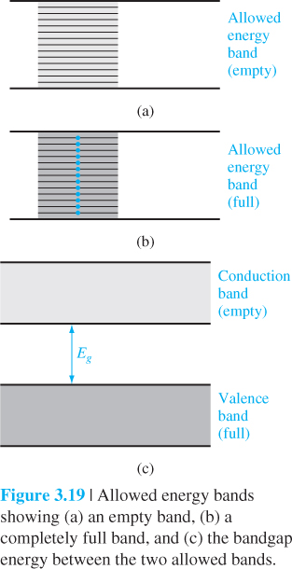
3.2.5 Metals, Insulators, and Semiconductors
an allowed energy band that is completely empty of electrons. If an electric field is applied, there are no particles to move, so there will be no current.
The bandgap energy Eg of an insulator is usually on the order of 3.5 to 6 eV or larger, so that at room temperature, there are essentially no electrons in the conduction band and the valence band remains completely full.

Slide 25
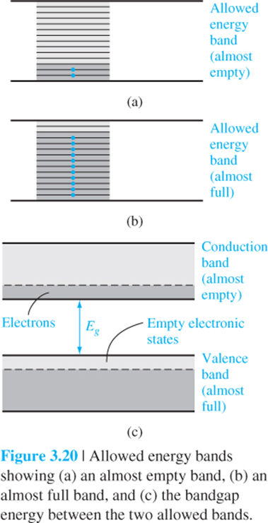
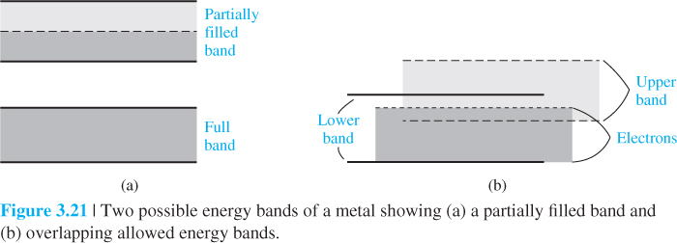
an energy band with relatively few electrons near the bottom of the band. Now, if an electric field is applied, the electrons can gain energy, move to higher energy states, and move through the crystal.
The bandgap energy may be on the order of 1 eV.
a partially full band in which there are many electrons available for conduction, so that the material can exhibit a large electrical conductivity
The band splitting into allowed and forbidden energy bands is a complex phenomenon, the conduction and valence bands overlap at the equilibrium interatomic distance.

Slide 26
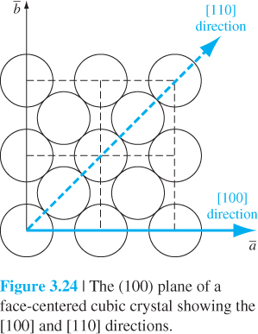
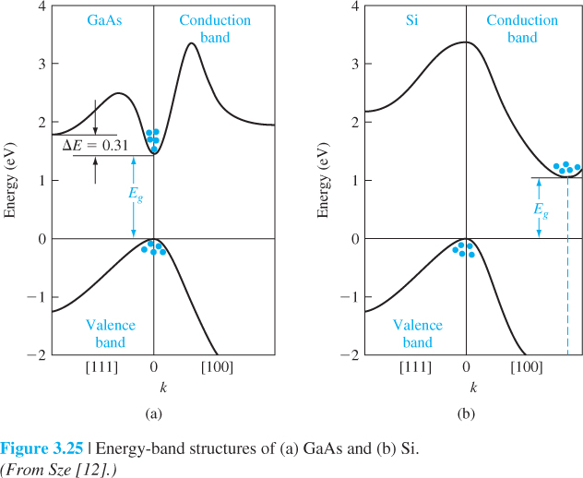
3.3 | EXTENSION TO THREE DIMENSIONS
3.3.1 The k-Space Diagrams of Si and GaAs
The E versus k diagram for the one-dimensional model was symmetric in k so that no new information is obtained by displaying the negative axis.
a face-centered cubic structure with the [100] and [110] directions. Electrons traveling in different directions encounter different potential patterns and therefore different k-space boundaries. The E versus k diagrams are, in general, a function of the k-space direction in a crystal.

Slide 27
In GaAs, the minimum conduction band energy and maximum valence band energy occur at the same k value. A semiconductor with this property is said to be a direct bandgap semiconductor.
A semiconductor whose maximum valence band energy and minimum conduction band energy do not occur at the same k value is called an indirect bandgap semiconductor.
3.3.2 Additional Effective Mass Concepts
the curvature of the conduction band at its minimum value for GaAs is larger than that of silicon, so the effective mass of an electron in the conduction band of GaAs will be smaller than that in silicon.
3.4 | DENSITY OF STATES FUNCTION
The number of carriers that can contribute to the conduction process is a function of the number of available energy or quantum states

Slide 28
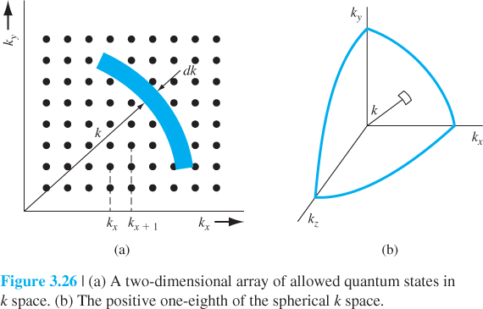

Slide 31
3.4.2 Extension to Semiconductors

Slide 32
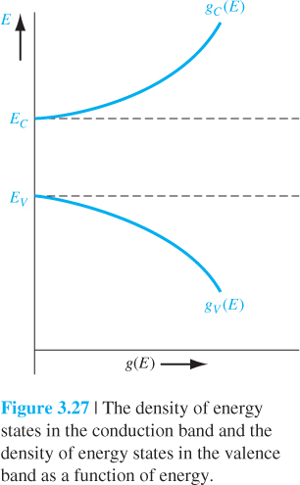

Slide 33
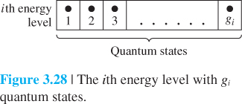
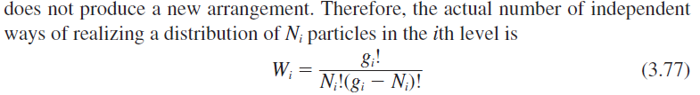
3.5 | STATISTICAL MECHANICS
3.5.1 Statistical Laws
One distribution law is the Maxwell–Boltzmann probability function, gas molecules.
A second distribution law is the Bose–Einstein function, photons.
The third distribution law is the Fermi–Dirac probability function, electron in crystal.

Slide 34
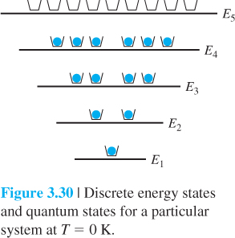
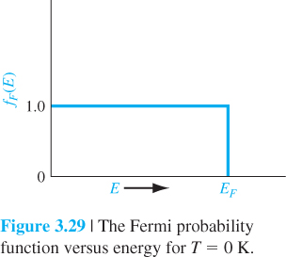
N(E) is the number of particles per unit volume per unit energy
g(E) is the number of quantum states per unit volume per unit energy.
f_{F}(E) is called the Fermi–Dirac distribution or probability function and gives the probability that a quantum state at the energy E will be occupied by an electron.
The energy E_{F} is called the Fermi energy.
f_{F}(E) is the ratio of filled to total quantum states at any energy E.
at T = 0 K, the electrons will be in the lowest possible energy state

Slide 35
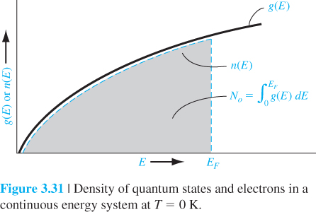
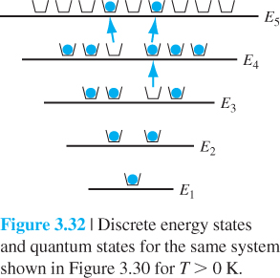
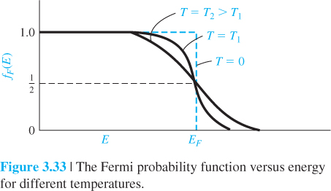

Slide 37
